Slide 1
Lecture 2
Brandon Moe

Slide 2
Todays Lesson
Wrap up common LabVIEW functions
WPI Robotics Library

Slide 3
Continued LabVIEW Functions

Slide 4


Commenting In LabVIEW
Double Click
A yellowish box will appear
Comment in Front panel
Comment in Block Diagram

Slide 5
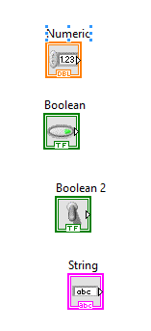
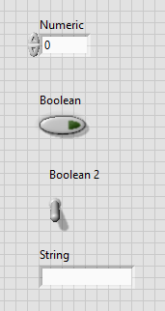
Controls

Slide 6
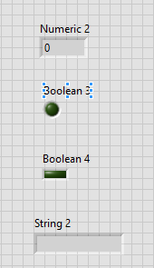
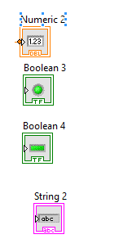
Indicators

Slide 7
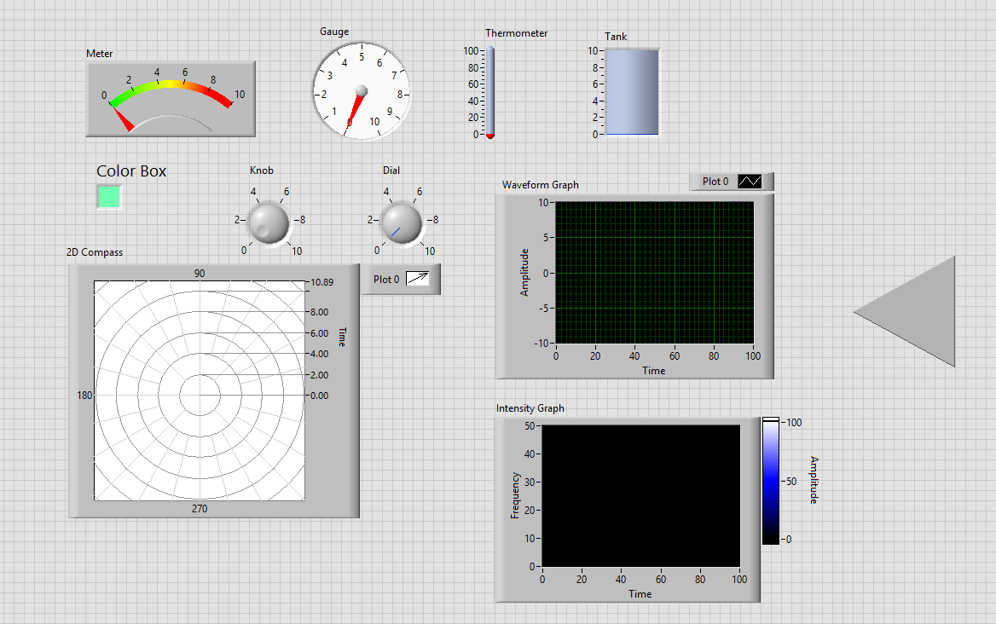
Other Front Panel Objects

Slide 8
WPI Robotics Library

Slide 9
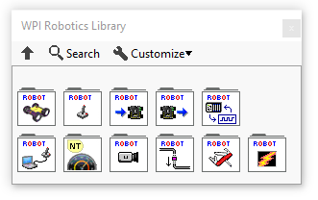
WPI Robotics Library
This is where you can find everything robotics related in LabVIEW
Located under the LabVIEW Pallet
Ex: joystick, motors, Talon SRX, pneumatics

Slide 10
Robot Drive

Slide 11
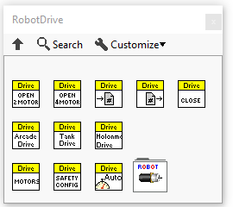
RobotDrive
Drive train initializing

Slide 12
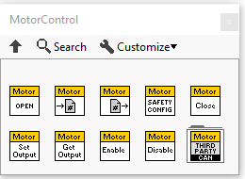
MotorControl
To control a single motor

Slide 13
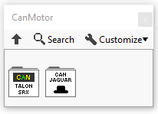
CAN Motors
Talon SRX (Comp Bot 2016, 2017)
Jaguar (Practice Bot)

Slide 14
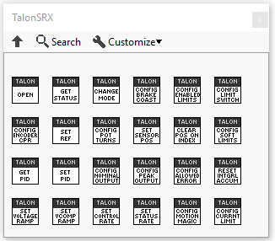
Talon SRX

Slide 15
Joystick

Slide 16
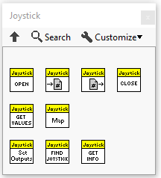
Joystick

Slide 17
Sensors and Actuators

Slide 18
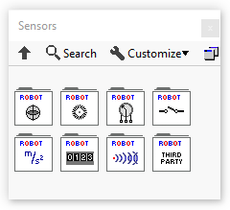
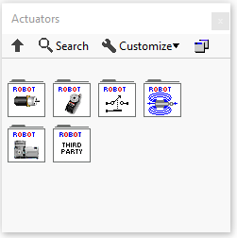
Actuators and Sensors
Actuators
Servo, relay, solenoid, compressor
Sensors
Gyro, Encoder, Potentiometer, switch, accelerometer, counter, ultrasonic, NavX

Slide 19
Local Variables

Slide 20
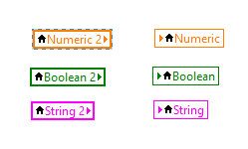
Local Variables
Can only pass information in one VI
Two Types
Read
Write

Slide 21
Shared Variables

Slide 22
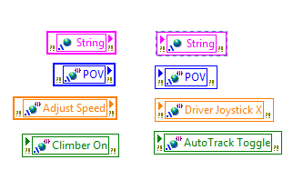
Shared Variables
Can be used anywhere in the program
has two types
Read
Write

Slide 23
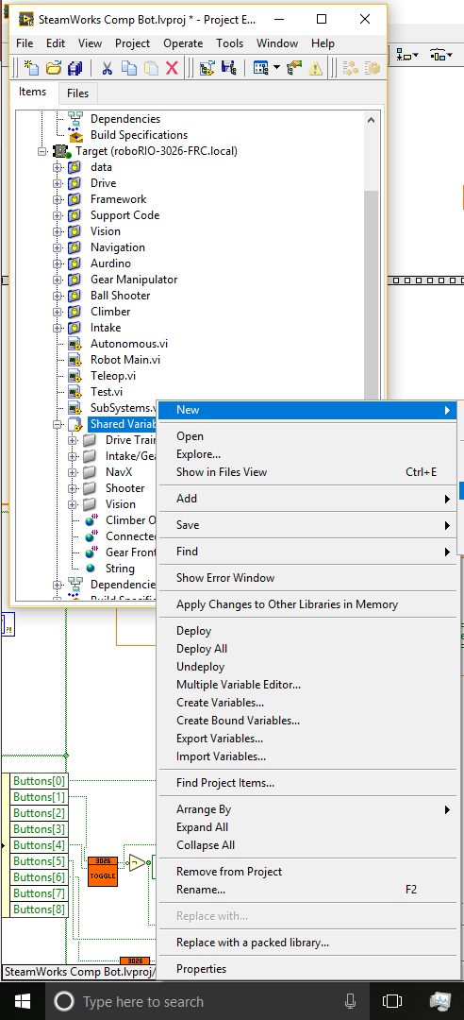
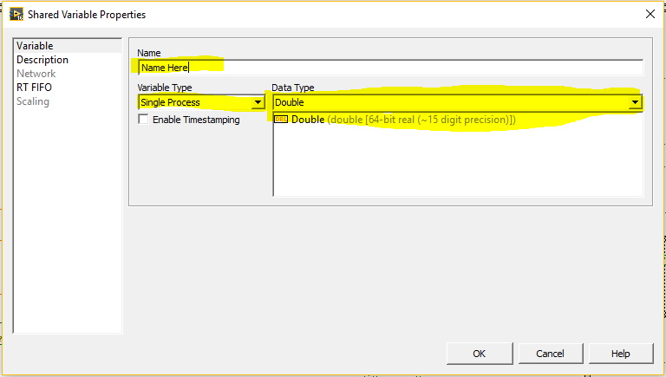
How to make a Shared Variable

Slide 24
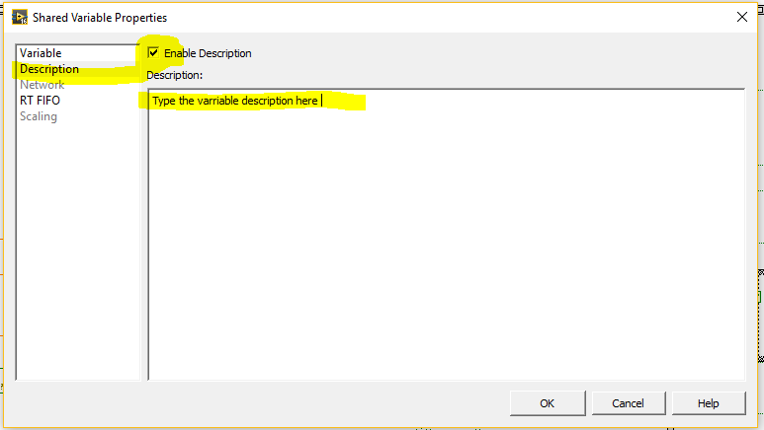

Slide 25
Reentrant VI’s

Slide 26
What is a reentrant VI?
http://digital.ni.com/public.nsf/allkb/98847B4E4C715E6D86256C59006B57CC

Slide 27

Project 1
Make a VI that has the following
Tank drive
Singular motor talon srx
Joystick
NavX
Solenoid
Servo
Compressor
Potentiometer
Ultrasonic Sensor
PID
While Loop
Case Statement
And, Or, and Not gate
String
Double
Integer
Pi
Greater than and Less than
Numeric Control and indicator
String Control and Indicator
Boolean Control and Indicator
Flat sequence with 3 frames
Expression node with formula 30x+26
Digital Input
Guage
Dashboard Read Boolean
Dashboard Write Boolean
For Loop (N=3026)
Shared Variable (boolean)
MAKE VI REENTRANT
THIS VI DOES NOT HAVE TO WORK!!!!

Slide 28
Turn In procedure
Upload VI into extra Vi’s folder
Name Project 1

